Slide 1


Institute of Advanced Computing and Software Development, Pune
Post Graduation Diploma in Big Data Analytics
Feb-2020
Book Recommendation System
By :
Gayatri Badgujar - 1308
Priyanka Kothawade - 1325
Project Guide
Mr. AKASHY TILEKAR

Slide 2
Contents
Objectives
Introduction
Flow of execution
Requirements
Dataset Description
Electronic design automation(EDA)
Methods and Algorithm
Result
Conclusion

Slide 3
Introduction
Book Recommendation system is used to recommend books to the users based on their interest and previous records. There are different ways to approach a recommendation system. They are basically divided into Content-based and Collaborative Filtering systems.

Slide 4
Objective
Developing a machine learning recommendation system which recommends the books to the user based on their interests and previous records.
Another objective is to build a recommendation system with good accuracy.

Slide 5
Flow of Execution
Loading Books and Rating Datasets.
Merging both dataset.
Data Cleaning.
Data Visualization.
Recommendation Systems.

Slide 6
Requirements
Data set : Books and Ratings Dataset
Software : Jupyter Notebook, Google colab
Programming language: Python and Machine learning
Libraries: 1) Data visualization: Plotly, Matplotlib
2) Machine learning: Sklearn, pandas,
Surprise, NumPy

Slide 7
Dataset Description
The BOOK Dataset consists of 10000 rows and 23 columns and The RATINGS dataset consists of 981756 rows and 3 columns. i.e. User-id Book-id and Ratings.
We merged the books and ratings dataset for Data visualization and recommendation system. We merged these two datasets based on Book-id.
After merging of two dataset the merged dataset consists of 23 columns.

Slide 8
Content based recommendation
Content Based Systems recommend items similar to those a user has liked (browsed/purchased) in the past.
Recommendations are based on the content of items rather on other user's opinion.

Slide 9
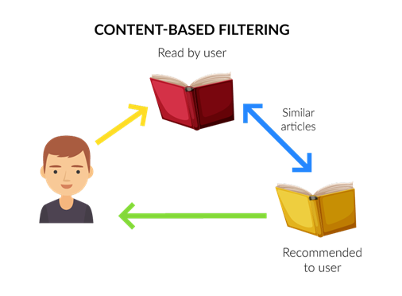

Slide 10
Content Based Process - TF-IDF
Each document is transformed into a normed TF-IDF vector, size N(Term Frequency/Inverse Document Frequency).
The distance between any pair of vector is computed.
TF-IDF Weight = TF (t,d) * IDF(t,D)

Slide 11
Cosine Similarity
Cosine similarity is a measure of similarity between two non zero vectors.
By Vector representation we can see how closely related two sentence are based on what angles their respective vectors make.
Cosine value ranges from -1 to 1.
If two vectors make an angle 0 then the sentences are closely related to each other.
If two vectors make an angle 90 then the sentences are almost unrelated.

Slide 12
Collaborative Filtering
Collaborative Filtering Method finds a subset of users who have similar tastes and preferences to the target user and use this subset for offering recommendations.
Basic Assumptions:
-Users with similar interests have common preferences.
-Sufficiently large number of user preferences are available.
Main Approaches:
-User Based
-Item Based

Slide 13
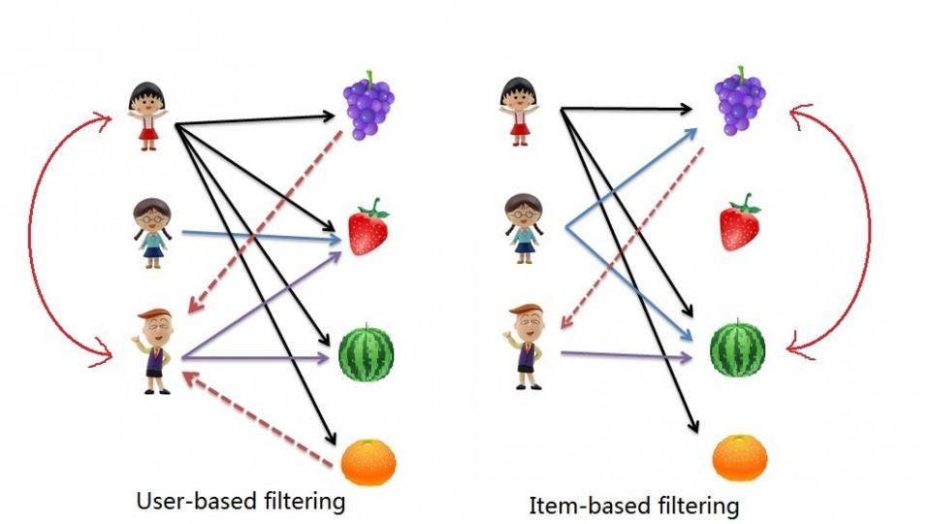

Slide 14
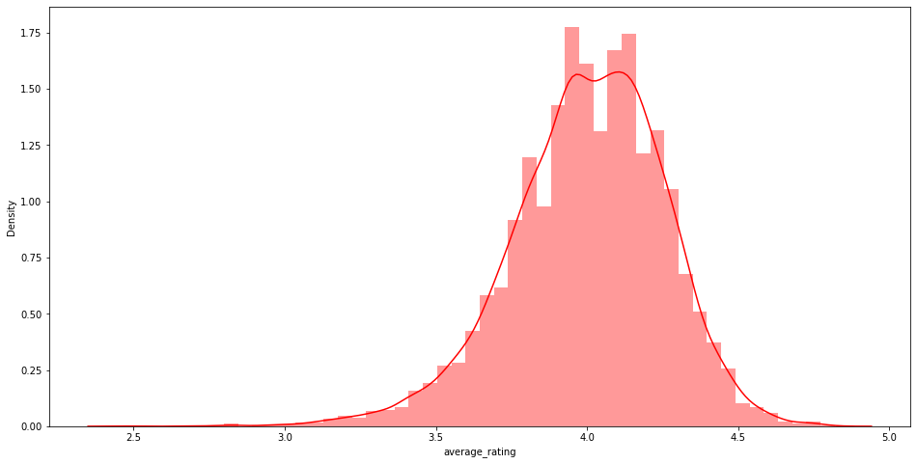
EDA
Most Common Rating Values

Slide 15
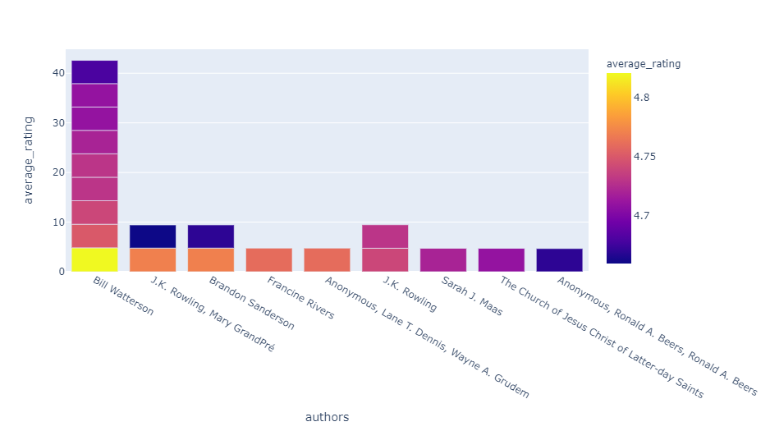
Highly rated authors

Slide 16
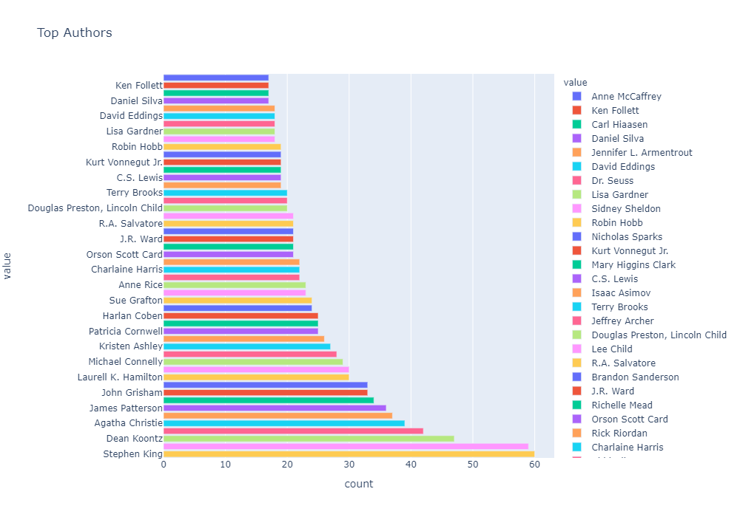
Top author frequency of the book

Slide 17
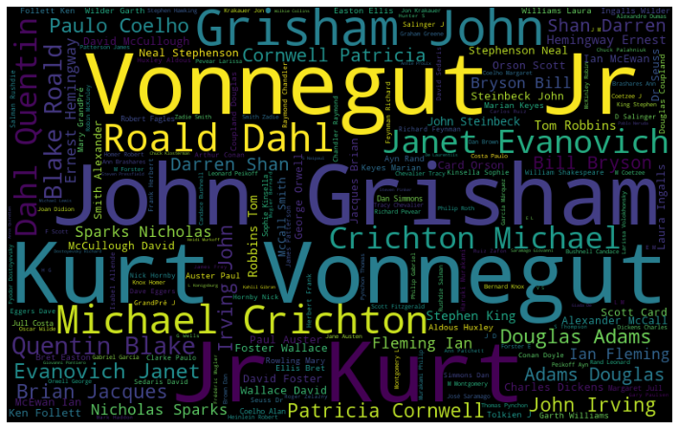
WordCloud of Author Names

Slide 18
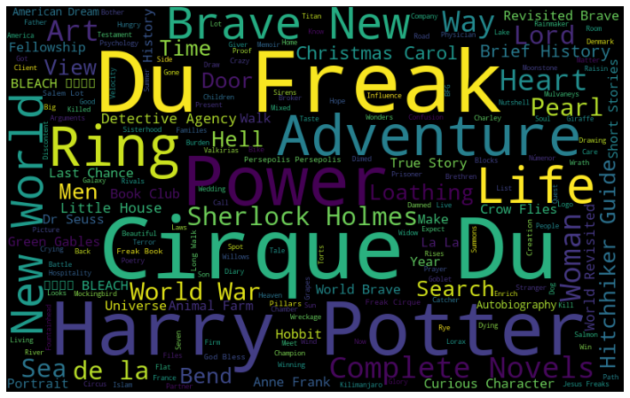
WordCloud Of Title of The Books

Slide 19
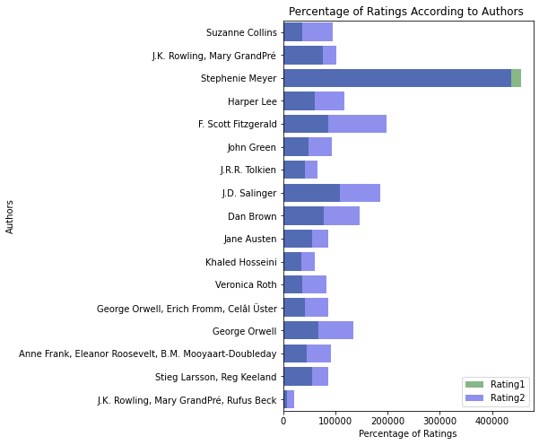
Percentage of Ratings According to Authors

Slide 20
Methods and Algorithms
Methods:
1. Content Based
2. Collaborative Filtering

Slide 21
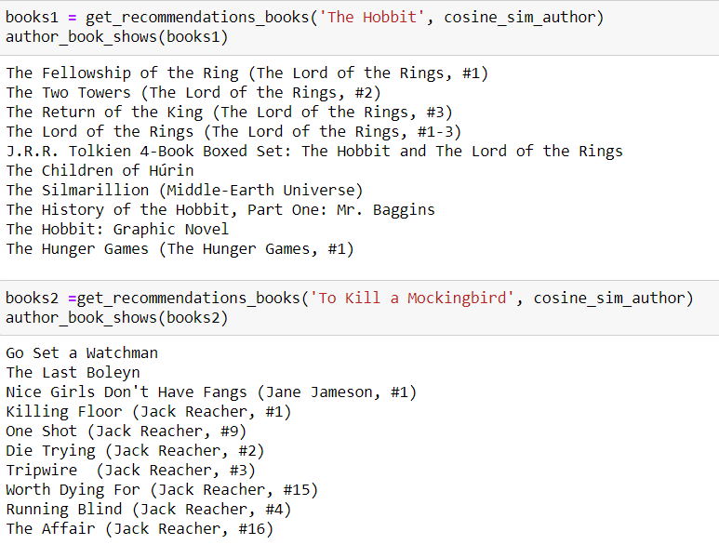
Content Based

Slide 22
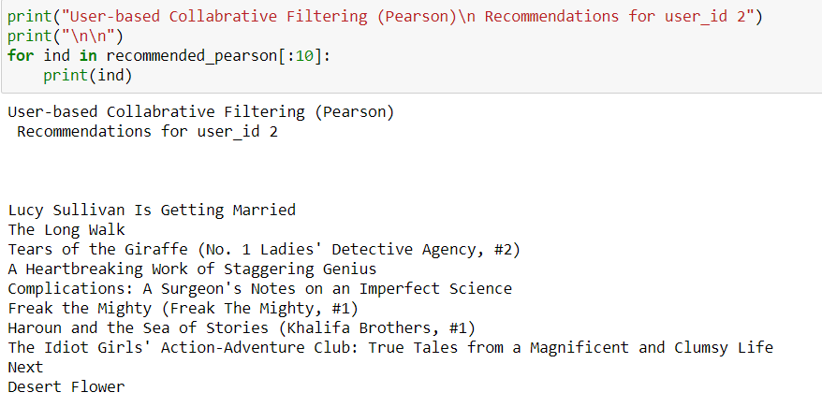
User Based Collaborative Filtering

Slide 23
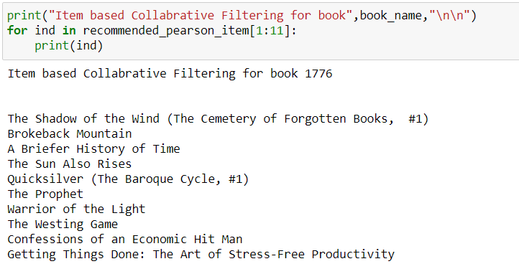
Item Based Collaborative Filtering

Slide 24
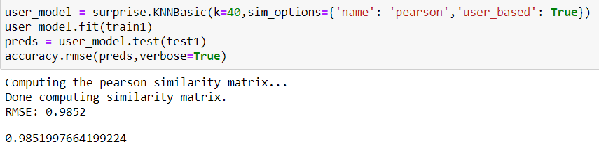
Accuracy : User Based

Slide 25
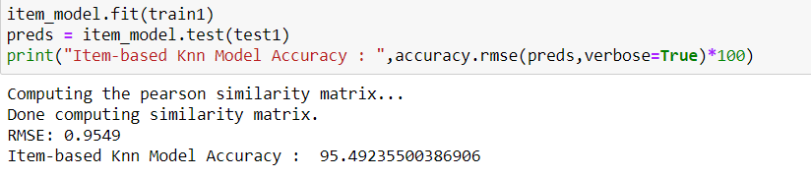
Accuracy : Item Based

Slide 26
Conclusion
In our project we have improvised and modiﬁed the recommendation systems. This Book Recommendation System has considered many parameters like ratings, book name, author name, image links etc. We successfully implemented and found the similar books using cosine similarity. Also, the recommendation system was implemented using book dataset and ratings dataset and KNN algorithm to display most similar books based on User based and Item based Collaborative Filtering.

Slide 27
THANK YOU!

